Slide 1
A Robust Heart Disease Prediction System Using Hybrid Deep Neural Networks
NAME: Sri Varsha Pasham
Student Id : 700759090
Corresponding author: Samina Amin
Date of Publication: 31 october 2023

Slide 2
Motivation
Heart disease or cardiovascular disease is one of the biggest reason for death across the globe.So, if somehow we manage to find the risk of someone having a heart disease beforehand then it would be helpful.
Challenges in HD Prediction: Complexity of HD makes it difficult for medical practitioners to diagnose promptly and accurately.
Role of Deep Learning (DL): DL-based systems show good efficiency in disease prediction and diagnosis.

Slide 3
Problem Statement
Heart Disease (HD): Leading cause of worldwide mortality according to WHO.
Annual Deaths: Approximately 17.9 million.
Significance: Early detection and accurate prediction are critical for timely medical interventions and improving patient outcomes.
This work introduces an enhanced and novel (HDNNs) system, utilizing a larger and a smaller dataset to design the system effectively.
Additionally, the proposed system was measured through comparison with conventional systems concerning sensitivity, Matthews Correlation Coefficient (MCC), F1-measure, accuracy, precision, AUC, and specificity.The promising accuracy achieved through the proposed system is 98.86%

Slide 4
Contributions
Models Used:
Artificial Neural Networks (ANN)
Convolutional Neural Networks (CNN)
Long Short-Term Memory (LSTM)
Hybrid CNN-LSTM with additional Dense layers
Four ML methods (SVM, KNN, DT, and RF)
Datasets Used
Cleveland Dataset
(Switzerland + Cleveland + Statlog +Hungarian+ Long Beach VA)
Preprocessing:
Data preprocessing was done on the collected data.
Feature Selection:
The method of feature selection involves picking features in order to reduce computational latency and complexity while boosting accuracy.

Slide 5
Objectives
Main Contribution: Design a robust HD prediction system using Hybrid Deep Neural Networks (HDNNs).
Method: Combining multiple neural network architectures to extract and learn relevant features from input data.
Train the model using two heart disease datasets:
UCI Kaggle Cleveland HD dataset (2 classes, 14 attributes,and 303 occurrences)
Comprehensive HD dataset combining (Switzerland, Cleveland, Statlog, Hungarian,Long Beach VA data.)includes 11 features, 1190 instances,and 2 classes.
The proposed system is implemented using the Anaconda framework(Jupyter Notebook) Python ,fundamental ML/DL libraries, including Scikit-learn NumPy, and TensorFlow ,

Slide 6
Continued
Data Splitting:
Data splitting is a technique that involves dividing a datasetinto smaller subsets.
Normalized preprocessed HD data is partitioned into two chunks (train, and test set).
Prediction Models:
After determining the features, the models were built using the four DL prediction and categorization techniques, including ANN, LSTM, CNN, and Hybrid CNN-LSTM.
One comparison is carried out with the individual method, where the hybrid CNN-LSTM model is tested against deep ANN, LSTM, and CNN methods.
The other comparison compares the performance of the proposed system with conventional ML techniques using deep neural networks.

Slide 7
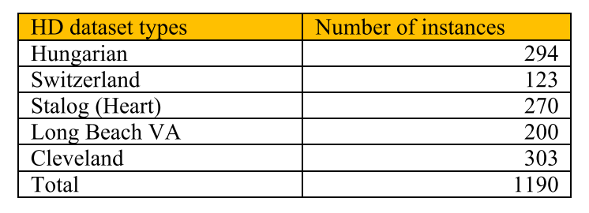
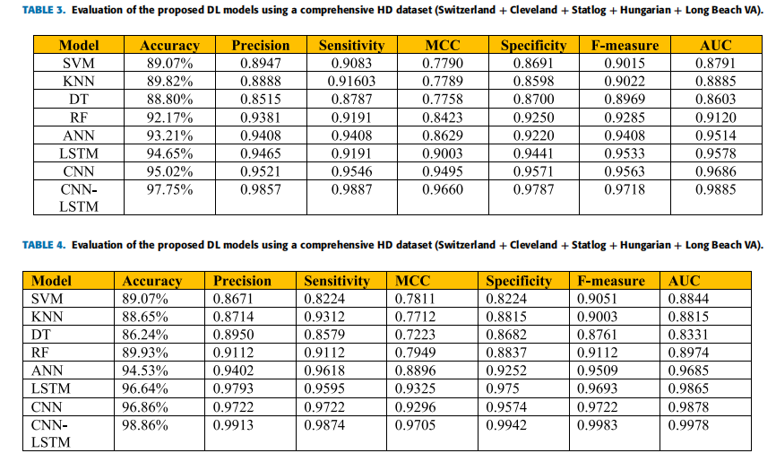
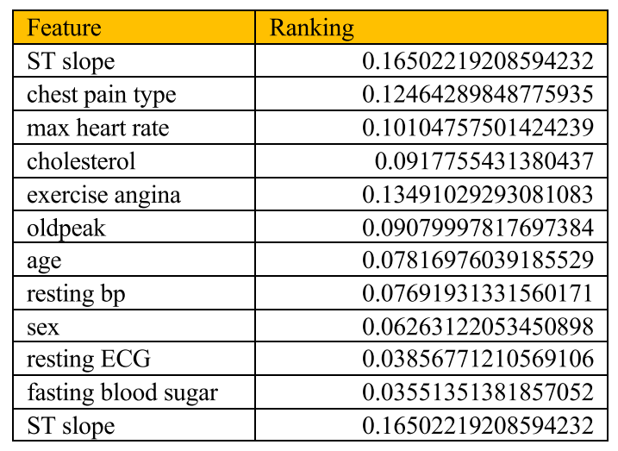
Results

Slide 8
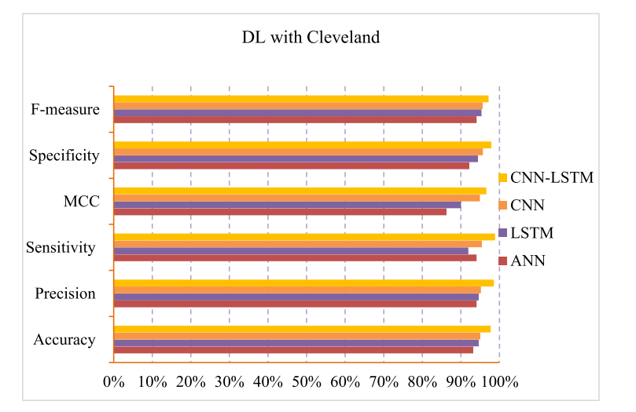
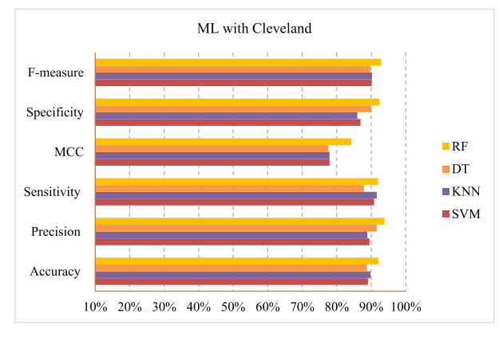
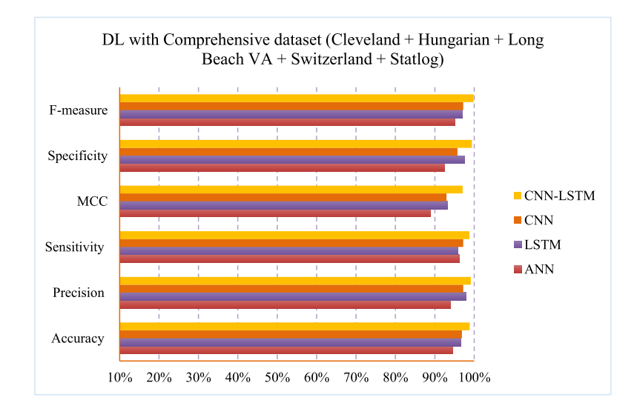
Continued

Slide 9
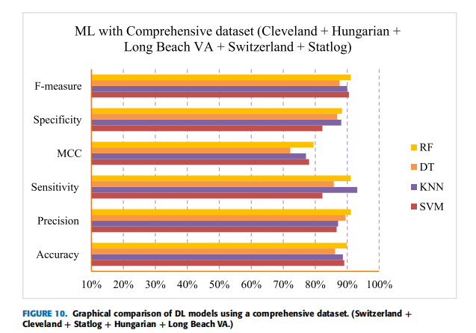
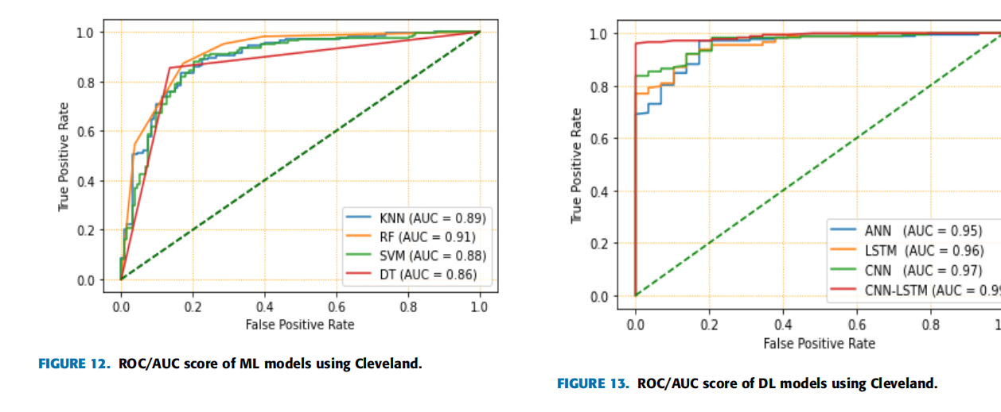
Continued

Slide 10
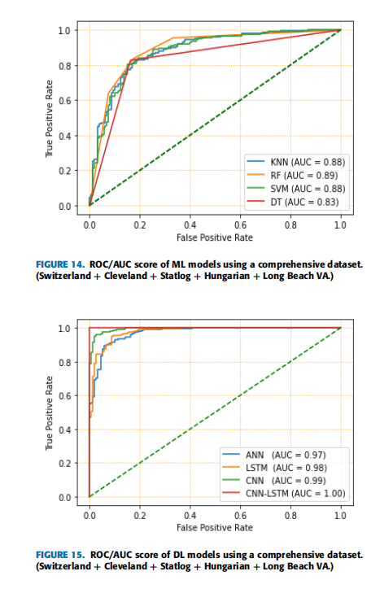
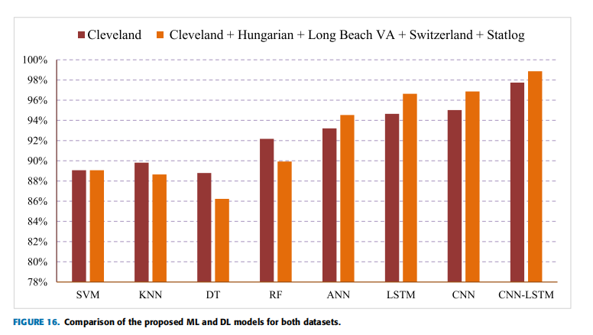
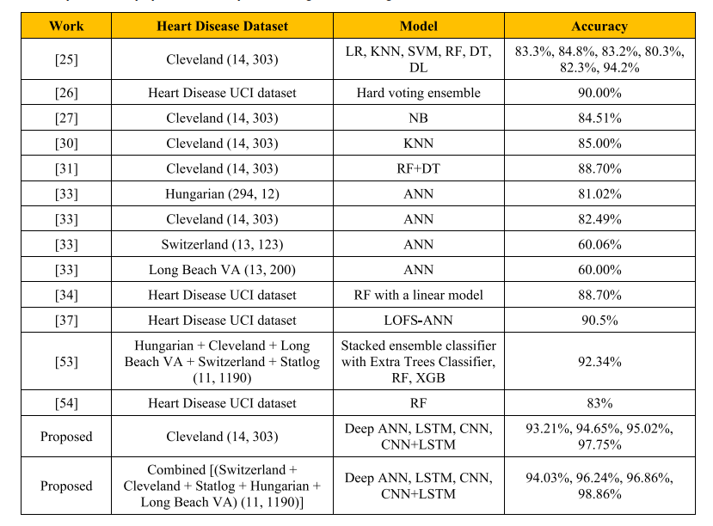
Continued

Slide 11
Critical Analysis
Combines Convolutional Neural Networks (CNN) and Long Short-Term Memory (LSTM) networks.Utilizes Dense layers for a comprehensive learning process.
Achieves 98.86% accuracy on two publicly available datasets.
Compared to the traditional ML and existing state-of-the-art, the proposed CNN-LSTM achieved the best
accuracy, precision, sensitivity, MCC, specificity, f-measure,and AUC of 97.75%, 0.9857, 0.9887,
0.9660, 0.9787, 0.9718,and 0.9885, respectively.
Employs diverse datasets (Cleveland HD dataset and a combined public HD dataset).Ensure generalizability and robustness of the model.
Assists healthcare professionals in early diagnosis and improving patient outcomes.
Improvements
Limited discussion on handling missing values, normalization, and feature selection.
Needs more extensive comparison with recent state-of-the-art models.
Potential risks of overfitting and dataset bias not thoroughly addressed.

Slide 12
References
[1] N. C. Long, P. Meesad, and H. Unger, ‘‘A highly accurate firefly based algorithm for heart disease prediction,’’ Expert Syst. Appl., vol. 42, no. 21,pp. 8221–8231, Nov. 2015, doi: 10.1016/j.eswa.2015.06.024.
[2] UDMI. Accessed: Jul. 24, 2023. [Online]. Available: https://www.udmi.net/cardiovascular-disease-risk/
[3] P. K. Mehta, S. Gaignard, A. Schwartz, and J. E. Manson, ‘‘Tradi tional and emerging sex-specific risk factors for cardiovascular dis ease in women,’’ Rev. Cardiovascular Med., vol. 23, no. 8, p. 288,2022.
[4] J. M. Alves-silva, M. Zuzarte, and H. Gir, ‘‘The role of essential oils and their main compounds in the management of cardiovascular disease risk factors,’’ Molecules, vol. 26, no. 3506, pp. 1–26,2021.
[5] C. Zhou, A. Hou, P. Dai, A. Li, Z. Zhang, Y. Mu, and L. Liu, ‘‘Risk factor refinement and ensemble deep learning methods on prediction of heart failure using real healthcare records,’’ Inf. Sci., vol. 637, Aug. 2023,Art. no. 118932, doi: 10.1016/j.ins.2023.04.011.
[6] F. Ali, S. El-Sappagh, S. M. R. Islam, D. Kwak, A. Ali, M. Imran, and K.-S. Kwak, ‘‘A smart healthcare monitoring system for heart disease pre diction based on ensemble deep learning and feature fusion,’’ Inf. Fusion,vol. 63, pp. 208–222, Nov. 2020, doi: 10.1016/j.inffus.2020.06.008.

Slide 13
Continued
[7] S. P. Barfungpa, H. K. D. Sarma, and L. Samantaray, ‘‘An intelligent heart disease prediction system using hybrid deep dense Aquila network,’’Biomed. Signal Process. Control, vol. 84, Jul. 2023, Art. no. 104742, doi:10.1016/j.bspc.2023.104742.
[8] S. Amin, B. Alouffi, M. I. Uddin, and W. Alosaimi, ‘‘Optimizing convo lutional neural networks with transfer learning for making classification report in COVID-19 chest X-rays scans,’’ Sci. Program., vol. 2022,pp. 1–13, May 2022, doi: 10.1155/2022/5145614.
[9] S.-C. Huang, A. Pareek, S. Seyyedi, I. Banerjee, and M. P. Lungren,‘‘Fusion of medical imaging and electronic health records using deeplearning: A systematic review and implementation guidelines,’’ NPJ Digit.Med., vol. 3, no. 1, p. 136, Oct. 2020.
[10] B. He, L. Bergenstråhle, L. Stenbeck, A. Abid, A. Andersson, Å. Borg,J. Maaskola, J. Lundeberg, and J. Zou, ‘‘Integrating spatial gene expression and breast tumour morphology via deep learning,’’ Nature Biomed. Eng.,vol. 4, no. 8, pp. 827–834, Jun. 2020.
[11] S. Amin, A. Alharbi, M. I. Uddin, and H. Alyami, ‘‘Adapting recurrent neural networks for classifying public discourse on COVID-19 symptoms in Twitter content,’’ Soft Comput., vol. 26, no. 20, pp. 11077–11089,Oct. 2022, doi: 10.1007/s00500-022-07405-0.

